Slide 1

Lecture 1
Intro to Command Line

Slide 2

Agenda
What is command line?
Command line variations
Operating command line

Slide 3
What is Command Line?

Slide 4
UI vs GUI
UI - User Interface
Everything (hardware, software, screens, menus, functions, outputs, and features) that affect two-way communications between the user and the computer
aka. the interface for you to operate the computer

Slide 5
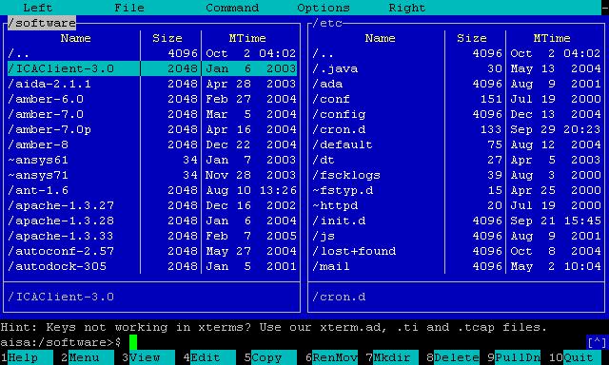
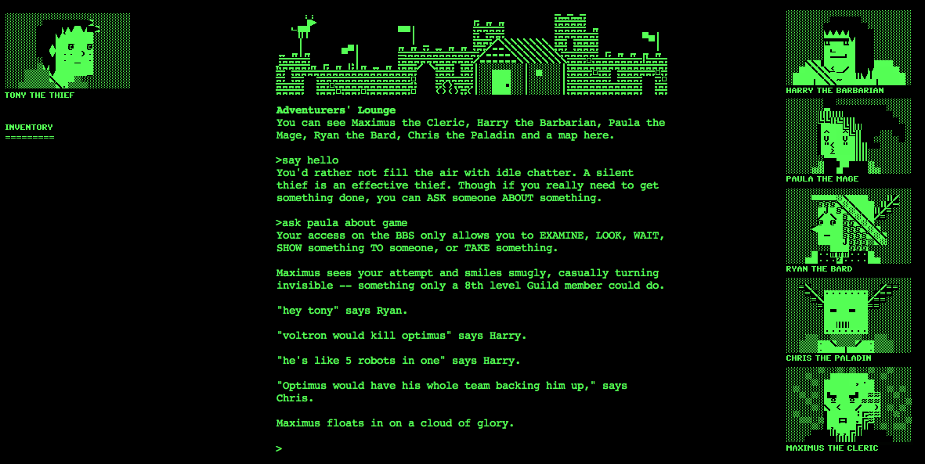
UI vs GUI
Text based UI
Text based Game

Slide 6
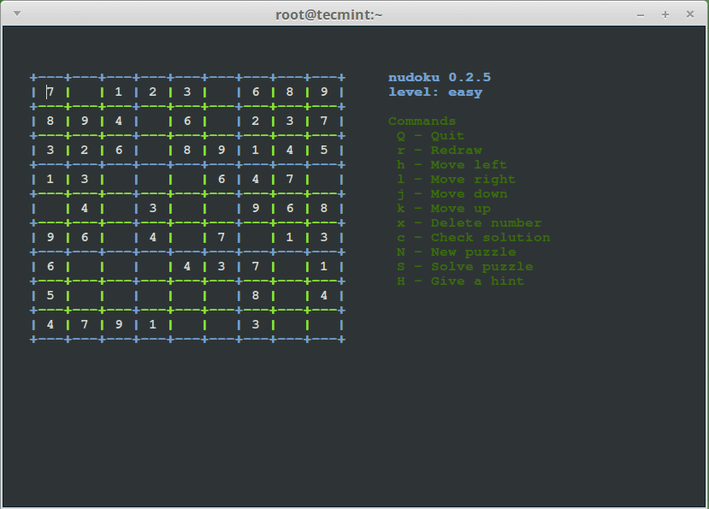
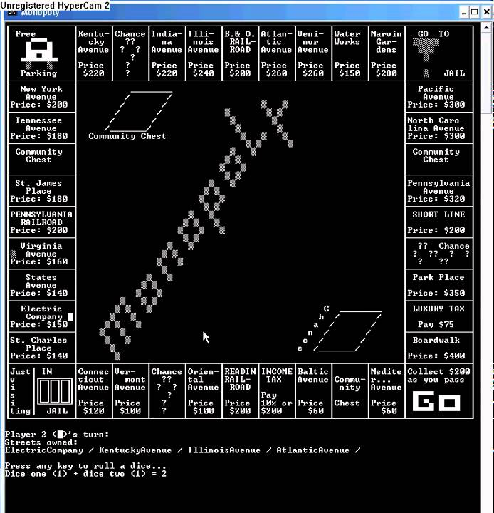
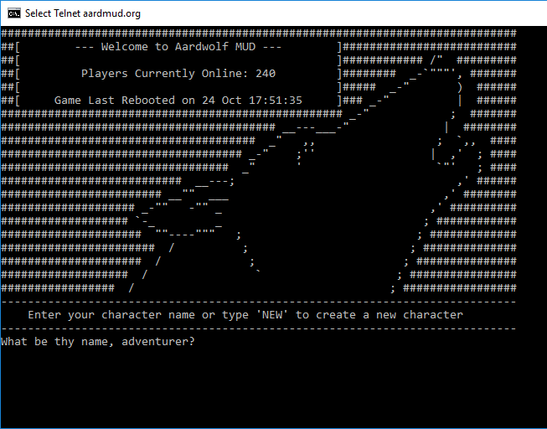
What you can do with Command Line?
Everything

Slide 7
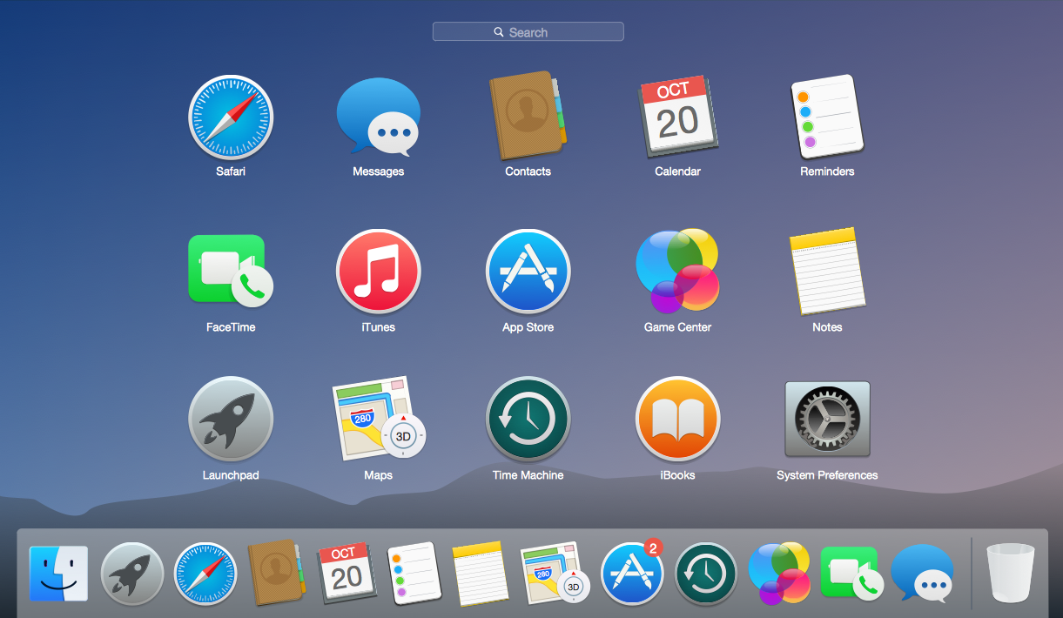
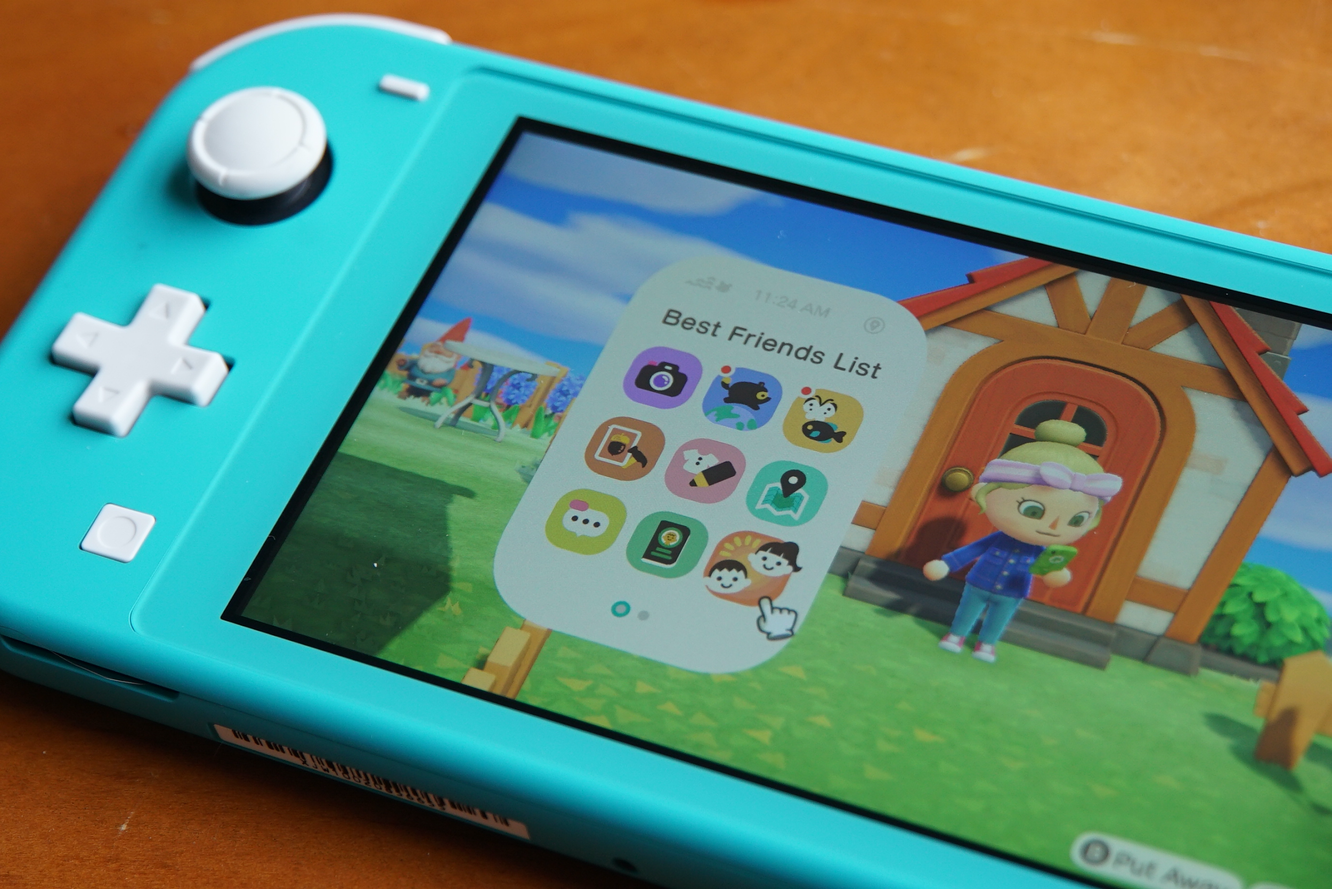
GUI
A GUI (graphical user interface) is a system of interactive visual components for computer software. A GUI displays objects that convey information, and represent actions that can be taken by the user. The objects change color, size, or visibility when the user interacts with them.

Slide 8
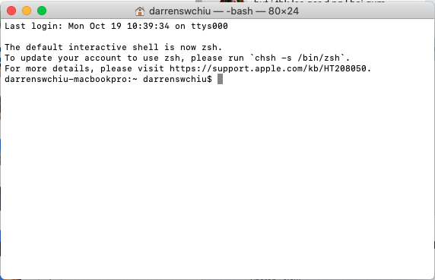
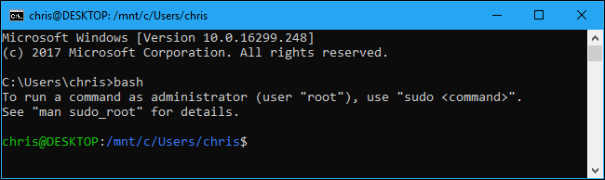
Modern Command Line
can still use “text” UI in modern computers
Mac: Terminal
Windows: cmd, Command Prompt, PowerShell

Slide 9
Variation of Command Lines

Slide 10
Command Line is not universal
There are many variations and versions of it
more than 20 different “Command Shells”
All are slightly different in command and features
Some important features are:
  Path Completion
  Command Name Completion
  Command History
  Colored Director Listings
OS | Default Shell
Windows (until Window Vista) | cmd.exe
Windows (post-Vista) | PowerShell (cmd.exe still available)
Mac OS (10.3-10.14) | bash (v4)
Mac OS (10.15+) | zsh (bash still available)
Linux | Bash (v4)

Slide 11
Operating Command Line

Slide 12
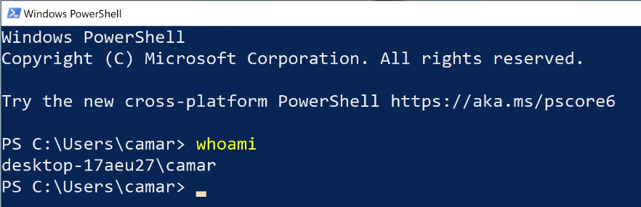
Greeting Messages
Current Location
Place for you to type your commands
Output for your command

Slide 13
File System Navigation
Command | Example | Feature
pwd | pwd | current directory
mkdir | mkdir talentlabsfolder | create a directory
ls | ls | list out all the files
cd | cd xx (.. means one layer up) | change directory
touch | touch file.txt (non-Windows) / ni file.txt (Windows Powershell) | create a file

Slide 14
Make File Changes
Command | Example | Feature
cp | cp file.txt file-copy.txt | Copy a file
mv | mv file.txt ../ | Move a file
rm | rm file.txt | rm something

Slide 15
Continuing Commands
Command | Example | Feature
cat | cat file.txt | Read a file
echo | echo “Hello World!” | Print something

Slide 16

There are a lot more about Command Line!
These are just the most commonly used ones.

